Slide 1
DOG BREED CLASSIFIER USING CNN
Presented by:
Hariharan E
III year, KVCET
NM ID - au421221243009
Email ID - hariyadav1301@gmail.com

Slide 2
PROBLEM STATEMENT
Manual identification of dog breeds from images is often time-consuming and error-prone.
There is a growing need for automated systems that can accurately and efficiently classify dog breeds from images in various domains such as veterinary care, pet adoption centers, and online platforms.

Slide 3
PROPOSED SOLUTION
Automated Dog Breed Identification:
Develop an automated system using Convolutional Neural Networks (CNNs) to accurately classify dog breeds from images.
Automated classification eliminates the need for manual identification, reducing time and errors in various applications such as veterinary care and pet adoption centers.
Utilization of Transfer Learning:
Incorporate transfer learning techniques to leverage pretrained CNN models for improved classification accuracy.
Transfer learning enables the model to leverage knowledge gained from largescale image datasets, enhancing its ability to classify diverse dog breeds effectively.

Slide 4
PROPOSED SYSTEM
Automated Dog Breed Classifier:
Develop a system that automatically identifies dog breeds from images using advanced computer vision techniques.
This system eliminates the need for manual identification, saving time and reducing errors in applications like veterinary care and pet adoption centers.

Slide 5
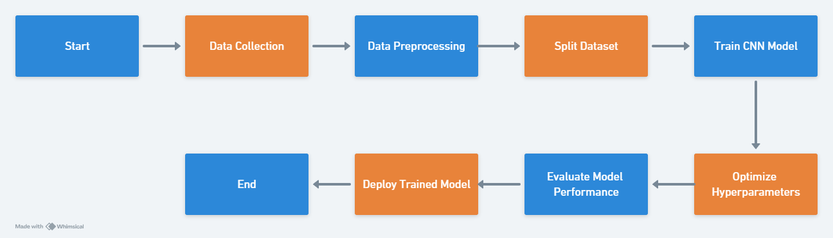

Slide 6
SYSTEM APPROACH
System Requirements:
Hardware:
1. Processing Power
2. Memory
3. Storage
Software:
1. Deep Learning Framework
2. Image Processing Libraries
3. Development Environment

Slide 7
ALGORITHM AND DEPLOYMENT
Algorithm Selection:
Choose Convolutional Neural Networks (CNNs) for their effectiveness in image classification tasks due to their ability to learn hierarchical features from raw pixel data.
Data Exploration:
Analyze the dataset to understand its structure, size, and class distribution, and visualize sample images from different dog breeds to gain insights into the dataset's characteristics.

Slide 8
Problem Formulation:
Formulate the problem as a supervised learning task where the objective is to classify input images into different dog breeds, defining the output space consisting of dog breed labels and determining evaluation metrics for model performance.
Deployment:
Train the selected CNN architecture using the annotated dog breed dataset, evaluate its performance, and deploy the trained model using a deployment platform such as cloud based services or on-premises infrastructure, providing an interface for user interaction.

Slide 9
TRAINING AND PROCESS
Data Splitting:
Split the dataset into training, validation, and test sets to assess the model's performance on unseen data and prevent overfitting. Common splits include 70,15,15 or 80,10,10 for training, validation, and testing respectively.
Feature Scaling:
Normalize or standardize the input features to ensure that they have a similar scale, preventing features with larger magnitudes from dominating the training process. Common techniques include minmax scaling or score normalization.

Slide 10
Model Training:
Train the selected CNN architecture using the training dataset, optimizing the model's parameters to minimize the loss function. Utilize backpropagation and gradient descent based optimization algorithms like Adam or SGD to update the model weights iteratively.
Model Evaluation:
Evaluate the trained model's performance using the validation set, assessing metrics such as accuracy, precision, recall, and F1score. Finetune hyperparameters based on validation performance to improve the model's generalization ability.

Slide 11
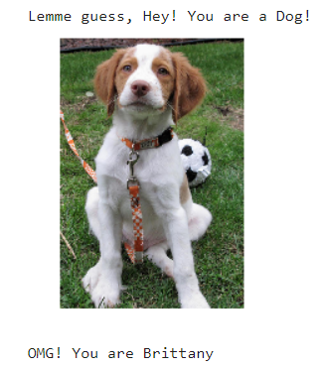
Output

Slide 12
PREDICTION PROCESS
New Data Input:
Accept input images of dog breeds from users or external sources for classification.
Preprocessing:
Preprocess the input images to ensure they are in the correct format and size required by the model. This may involve resizing, normalization, and augmentation to enhance model performance.

Slide 13
Model Inference:
Feed the preprocessed images into the trained CNN model for inference, where the model computes the probabilities of each dog breed class for the input image.
Result Interpretation:
Interpret the model's output probabilities to determine the predicted dog breed for the input image. The breed with the highest probability score is considered the predicted label.
Provide the user with the predicted dog breed along with the confidence score to convey the model's certainty in its prediction.

Slide 14
RESULT
Achieved a more classification accuracy on the test dataset, demonstrating the model's ability to accurately classify dog breeds from images.
Evaluated other metrics such as precision, recall, and F1score, indicating the model's robust performance across different evaluation criteria.

Slide 15
CONCLUSION
The Dog Breed Classifier project has demonstrated the feasibility and effectiveness of using deep learning techniques, specifically Convolutional Neural Networks (CNNs), for automated dog breed identification. By achieving a high classification accuracy on the test dataset and robust performance across various evaluation metrics, the model has showcased its ability to accurately classify dog breeds from images.

Slide 16
FUTURE SCOPE
Enhanced Model Architecture:
Explore advanced CNN architectures and techniques such as attention mechanisms or capsule networks to improve classification accuracy and robustness.
Multimodal Learning:
Investigate multimodal learning approaches that incorporate additional information such as text descriptions or audio cues to enhance dog breed classification performance.
Continual Learning:
Implement continual learning strategies to adapt the model over time and accommodate new dog breeds or variations in appearance.

Slide 17
REFERENCES
Yan, LeCun. "Deep Learning and Convolutional Neural Networks." Available online: http://yann.lecun.com/exdb/publis/index.html
Goodfellow, Ian, et al. "Deep Learning." MIT Press, 2016.
Hrushevsky, Alex, et al. "ImageNet Classification with Deep Convolutional Neural Networks." Advances in Neural Information Processing Systems, 2012.
Simonyan, Karen, and Andrew Zisserman. "Very Deep Convolutional Networks for Large-Scale Image Recognition." arXiv preprint arXiv:1409.1556, 2014.

